Slide 1
CSE7302 - INTERNSHIP Review-3 Presentation Design and Development of a React-Based Front-End Web Application
Under the Supervision of,
Ms. Thabassum Khan
Assistant Professor
Presidency School of CSE
Presidency University
Student Details
Name | KAVYA S
Roll No | 20221CBD0021
Section | 8CBD1
Name of the Program: Computer Science Technology(Big data)
Name of the HoD: Dr. Pravinth Raja
Name of the Program Internship Coordinator: Ms. Nisha Robin Rohit
Name of the School Internship Coordinator: Dr. Md Ziaur Rahman

Slide 2
Content
About Company or Organization
Working domain or the technology
About your team and reporting Manager
Challenges Faced in Internship
Objectives of the work
Literature Review
Proposed System
Problem Statement
System Requirements
Advantages of Proposed System/Work
System Design
System Implementation
Internship Roadmap
Github Link

Slide 3
About Company or Organization
Revonextsoft – A Revolution in Next Generation Software Development
Revonextsoft is a technology-driven software company focused on delivering innovative, scalable, and future-ready digital solutions.
The company specializes in helping businesses transform their ideas into powerful software products.
With a strong focus on quality, performance, and client satisfaction, Revonextsoft partners with organizations across industries to drive digital growth.
🌐 Website: https://revonextsoft.com/

Slide 4
Working domain or the technology
Domain: Front-End Development
Technology: HTML, CSS, React.js
During the internship, the focus was on understanding system requirements and designing a user-friendly children’s event management website, followed by implementing a React-based static front end using a component-based approach for scalability and performance.

Slide 5
About your team and reporting Manager
Reporting Manager We reported to Mr. Jebin M, a senior employee specializing in full-stack web development, who assigned tasks and guided us throughout the internship.
Guidance & Support He provided continuous mentoring, reviewed our work, and helped us improve our technical and design skills.
Team Structure We worked as a team under his supervision, collaborating closely to complete assigned tasks efficiently.
Confidentiality Due to company confidentiality policies, specific team member names and detailed project information cannot be disclosed.

Slide 6
Challenges Faced in Internship
Team Coordination Working in a team of five members took time to adjust to communication and collaboration.
Design Expectations & Rework The mentor had high design expectations, leading to multiple revisions in the React static website project.
Lack of Version Control (Git) Not using Git initially made it difficult to track changes, and sharing code via WhatsApp was unorganized.
Research & Requirement Understanding Searching online resources and aligning the project with company requirements was challenging.

Slide 7
Objectives of the work
To design and develop a complete static website using React for an event management platform.
The website is focused on children’s events, which can be accessed by parents and schools.
To act as a mediator between event-organizing companies and parents, making event discovery easier.
To allow parents to find and register children for events without manually searching for each event (similar to Olympiad registrations).
To create a user-friendly and informative interface for the platform named SchoolEvents.

Slide 8
Literature Review
Reviewed existing event management and registration websites used for children’s activities and competitions.
Studied static and dynamic React-based websites to understand layout structure and component usage.
Analyzed platforms similar to Olympiad and school event registration systems to understand user flow.
Referred to online resources, tutorials, and documentation for React UI design and best practices.
Identified key features such as easy navigation, clear event listing, and user-friendly design.

Slide 9
Proposed System / Work
A React-based static website is proposed for a children’s event management platform named SchoolEvents.
The system provides a centralized platform where parents and schools can view available events in one place.
It acts as a bridge between event organizers and parents, reducing the need for manual event searching.
The website displays event details, categories, and basic registration information in a user-friendly manner.
The focus is on simple design, easy navigation, and responsive layout for better user experience.

Slide 10
Problem Statement
There is no centralized platform for accessing information about children’s events, resulting in fragmented and time-consuming event discovery. Parents and schools must manually search and register for multiple events across different sources. This creates a need for a unified, user-friendly system to simplify event listing and participation.

Slide 11
System Requirements
Operating System Any modern operating system such as Windows, macOS, or Linux is required.
Web Browser Latest browsers like Google Chrome or Microsoft Edge are used for testing and viewing.
Frontend Framework React.js with Vite is used for fast, efficient development and project bundling.
Hardware Requirements Minimum 4 GB RAM and a standard processor are sufficient for development.

Slide 12
Advantages of Proposed System/Work
Centralized Event Information Provides a single platform to view all children’s events in one place.
Time-Saving Reduces the need for parents and schools to manually search for events.
User-Friendly Interface Simple and clear design makes navigation easy for all users.
Better Communication Acts as a bridge between event organizers and parents/schools.
Improved Accessibility Events can be accessed anytime through a web browser.

Slide 13
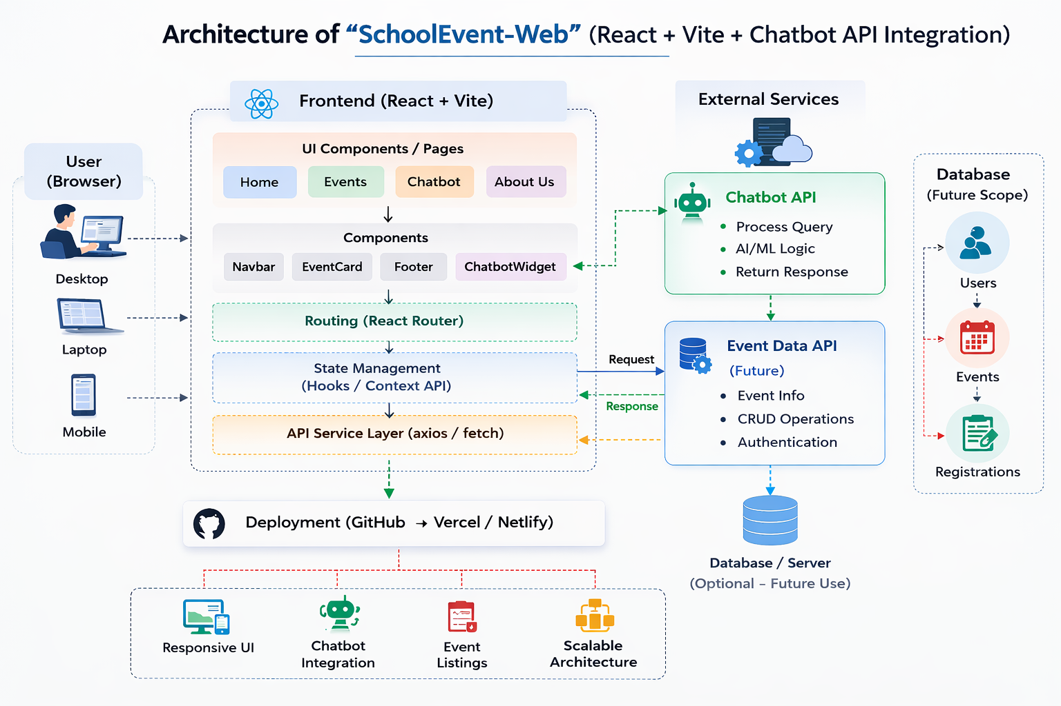
System Design

Slide 14
System Implementation (At least 50%)
Project Setup – Initialized the project using React with Vite for fast development. Installed all required dependencies and configured the basic folder structure.
UI Development – Designed Home, Events, and Chatbot pages using reusable components. Ensured a clean layout and responsive design using CSS.
Routing & State – Implemented navigation using React Router for smooth page transitions. Managed application data and chatbot messages using React Hooks.
Chatbot API Integration – Connected the frontend with the chatbot API using POST requests. Displayed dynamic responses based on user input.
Testing & Deployment – Tested the application using browser developer tools and fixed errors. Pushed the code to GitHub and deployed the application online.

Slide 15
Internship Road Map
Note: Write in the below table what u will be achieving in each review
Review 1
Review 2
Review 3
Review 4
Final Review
Introduction to the company, project requirements, and basics of React with Vite.
Improved UI planning skills and developed reusable React components with basic styling.
Enhanced frontend skills by building multi-page improving design consistency, component reusability.
Strengthened frontend development through UI refinement, responsiveness, and code optimization.
Gained hands-on experience in frontend development by working on multiple React projects and real-time tasks.

Slide 16
Github Link
GIT-HUB LINK https://github.com/kav-star/schooevent-web.git

Slide 17
Q&A

Slide 18
Thank you !!

